Slide 1
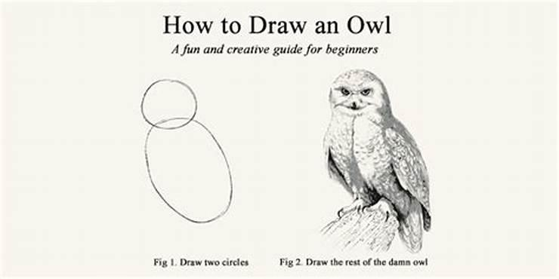
Project
Use a provided dataset (or bring your own) to create a visualization

Slide 2
Project Goal
Create and save a script that does the following:
Imports your dataset or one of the provided CSV files
Loads needed libraries
Filters to a specific subset of data (optional)
Using ggplot, visualize some aspect of the data
Use the template, or create your own project / script
Remember! It’s OK to Google how to do something. I do it for EVERY script

Slide 3
Project Steps
Choose a dataset
Open in Excel to look at data
Create a new directory/project & copy over all needed files (not required, but good practice)
Create & save a blank (.R) script file
Import data into R
Perform needed data manipulation
View data, decide what to visualize
Plot in ggplot (and troubleshoot along way)

Slide 4
Example Projects
Some example projects that you could do are:
Tanner crab chela width vs crab width
Pink salmon harvest by district
Sockeye ASL (can be left_join’d with Sockeye Origin for extra fun)
You are welcome (and expected) to copy code over that we’ve done together. Read error statements closely. Google your problems.
If you want to pair up and work on the same dataset, it’s great to talk it out and share code! However, write as much individually as you can: the more you write, the more the ideas are cemented

Slide 5
Work on Projects
Good luck! We’ll help folks as needed during this time
Start simple, work up to complicated.
Send us some of your plots by email / chat!

Slide 6
Project Steps
Some example projects…
Tanner crab chela width vs crab width
Pink salmon harvest by district
Sockeye ASL (can be left_join’d with Sockeye Origin for extra fun)
Choose a dataset
Open in Excel to look at data
Create a new directory/project & copy over all needed files (not required, but good practice)
Copy over all needed files
Create & save a blank (.R) script file
Import data into R
Perform needed data manipulation
View data, decide what to visualize
Plot in ggplot (and troubleshoot along way)
If you finish early, you can:
Message & help others
Make more plots
Google other “touch ups”
Do some simple analysis / summaries
If you feel like you’re not making progress that’s fine! Message us or a peer ☺

